Slide 1
ConnectTEL
CUSTOMER CHURN
EDA & PREDICTION
By: Obey Peace

Slide 2
Brief overview of the project:
This project focuses on analyzing telecom customer churn, a critical issue in the telecommunications industry.
Objectives of the analysis:
Our main objectives are to understand the factors influencing customer churn and to develop predictive models to identify at-risk customers.
Importance of understanding customer churn:
Understanding customer churn is vital for telecom companies as it impacts revenue, customer satisfaction, and market competitiveness.

Slide 3
Description of the dataset:
We obtained a dataset containing information on telecom customers, including demographic details, service subscriptions, billing information, and churn status. The dataset comprises 7043 observations and 21 features.
Procedure
Identify problem statements
Exploratory data analysis
Feature engineering
Feature selection
Handling imbalance data
Model selection
Create and deploy model

Slide 4
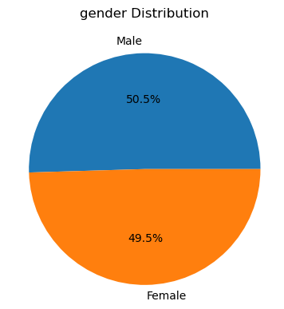
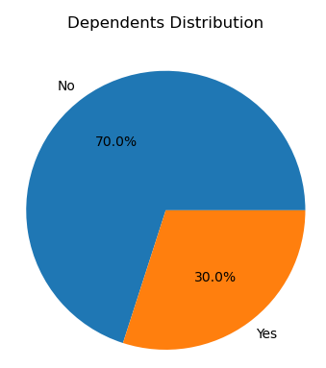
EDA
1. Customer Demographics
Males are slightly more prevalent (50.48%) than females.
A majority (51.7%) have no partners and 70% have no dependents.
Conclusion: Family structure might not be a significant factor in churn.

Slide 5
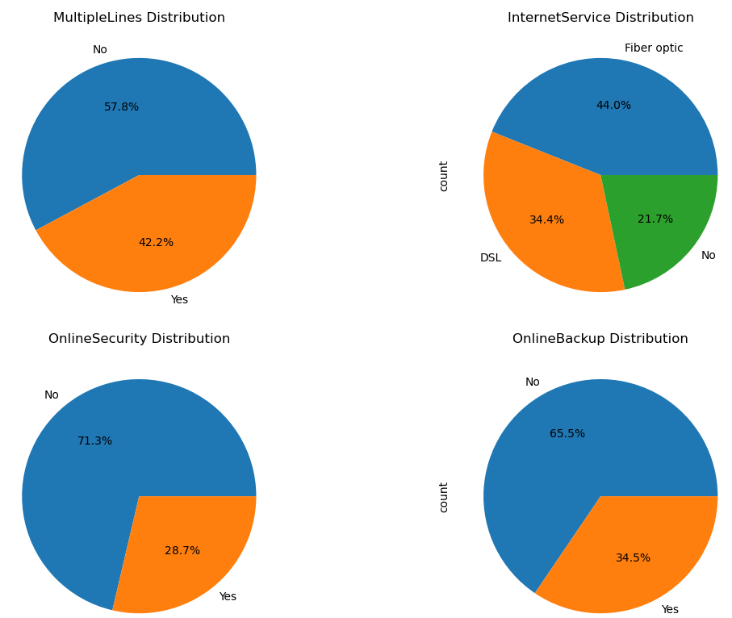
EDA
2. Service Usage
High phone service penetration (90%) with a preference for multiple lines (58%).
Lower adoption of internet services (44%).
Low usage of protection/security services (online security: 29%, device protection: 34%, tech support: 29%, online backup: 39%).
Streaming services have moderate adoption (TV: 39%, Movies: 39%).

Slide 6
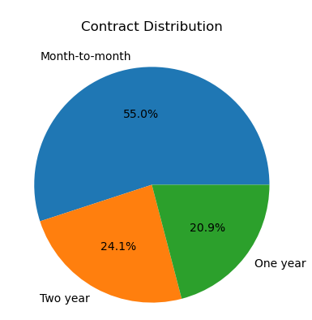
EDA – Churn Analysis
3. Contract & Payment
Majority use paperless billing (59%) but prefer credit cards (41%) over electronic checks (unknown %).
Month-to-month contracts are more popular (55%) compared to longer terms.
Customers value convenience (paperless billing) and flexibility (month-to-month contracts).

Slide 7
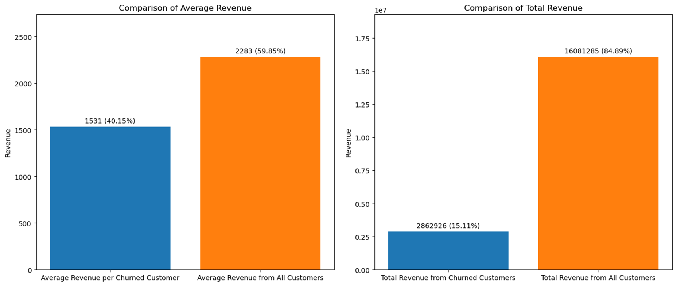
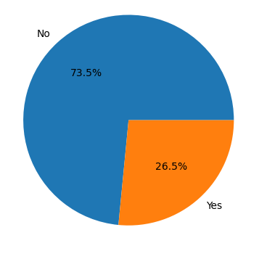
EDA – Churn Impact
Churn rate is 27%.
Revenue loss due to churn is 17.83%.
Churned customers have lower average revenue than retained customers.

Slide 8
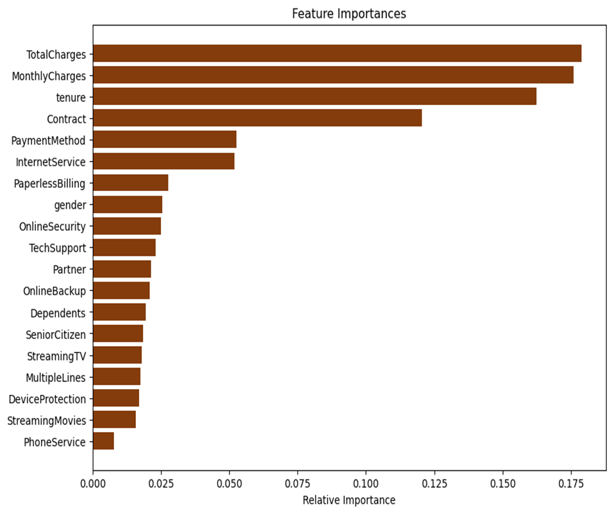
EDA – Churn Impact
Feature Importance
TotalCharges, MonthlyCharges, tenure, contract type, and payment method emerge as the top five features influencing churn.

Slide 9
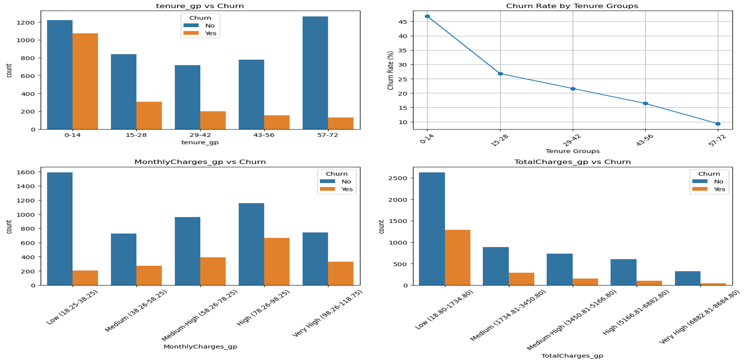
EDA – Churn Analysis
Tenure, monthly charges, and total charges are key churn predictors (shorter tenure, higher monthly charges, lower total charges correlate with churn).
Conclusion: Churn has a significant financial impact. Understanding customer behavior across these dimensions is crucial.

Slide 10
EDA – Churn Analysis
Other Observations:
No significant churn difference based on gender.
Customers with partners and dependents churn less.
Churn is higher for customers with phone service, online security, online backup, but lower for those without device protection, tech support, or streaming services.
Paperless billing and electronic check payments correlate with higher churn, while credit cards correlate with lower churn.
Notably, customers with fiber optic internet and those without online security or tech support exhibit higher churn rates.
Non-senior citizens churn more.
Customers with month-to-month subscriptions have a higher churn proportion while those with two year subscriptions have lower churn proportion.

Slide 11
Model Building – Processing steps
11 missing values in the Total Charges column – replaced with the median value of the feature
Imbalanced Churn Proportion: No – 5174
Yes - 1869.
Under-sampling was carried out to balance the dataset
New Features were created: tenure_gp, MonthlyCharges_gp, TotalCharges_gp
Redundant features were dropped: CustomerID,

Slide 12
Model Building
Scaling: MinMaxScaler() - transforms the values of the features to a range of 0 and 1
Encoding: LabelEncoder() – transforms categorical features into numerical features
Models: LogisticRegression(max_iter=1000), SVC(),
KNeighborsClassifier(),
RandomForestClassifier(), XGBClassifier(),
GradientBoostingClassifier(),
DecisionTreeClassifier()
Model Hyperparameter Optimization
Model Building and Evaluation (test and train dataset)
Building a predictive system
Productionizing the best performing model as a pickle file

Slide 13
Model Performance Comparism
Model | Accuracy | F1 Score | ROC-AUC | Precision | Recall
LogisticREgression() | 0.76 | 0.77 | 0.76 | 0.74 | 0.80
SVC() | 0.75 | 0.77 | 0.75 | 0.72 | 0.82
KNeighborsClassifier() | 0.71 | 0.72 | 0.71 | 0.68 | 0.77
RandomForestClassifier() | 0.74 | 0.74 | 0.74 | 0.74 | 0.75
GradientBoostingClassifier() | 0.75 | 0.76 | 0.75 | 0.73 | 0.80
DecisionTreeClassifier() | 0.67 | 0.67 | 0.67 | 0.67 | 0.68
XGBClassifier() | 0.73 | 0.74 | 0.73 | 0.73 | 0.75

Slide 14
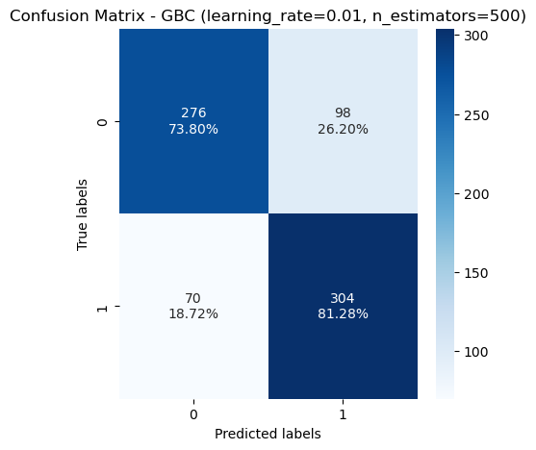
Model Building
In a customer churn prediction project, focusing on false negatives (missed churn) is generally more important than false positives (incorrectly predicting churn). Here's why:
Cost : Retaining an existing customer is typically much cheaper than acquiring a new one.
Impact of False Negatives: When a customer churns and the model fails to predict it (false negative), you miss the opportunity to intervene and potentially retain them.
Impact of False Positives: While a false positive means you might unnecessarily reach out to a customer who isn't going to churn, the cost of such outreach is typically lower compared to losing a customer entirely.
Optimized GBC Model gave the lowest false negative of 98, and a high accuracy score of 78%

Slide 15
Recommendations
Targeted Bundling:
Offer bundled packages that combine high phone service penetration (multiple lines) with high-value internet options.
Consider including basic online security features in these bundles to address low adoption rates and potentially increase perceived value.
Security & Support Package:
Develop a comprehensive security & support package that combines online security, device protection, tech support, and online backup.
Offer this package at a discounted rate compared to purchasing services individually to incentivize adoption and address low usage rates.

Slide 16
Recommendations
Flexible Payment Options with Incentives:
While customers value convenience (paperless billing), explore offering incentives for automatic payments via credit card (lowest churn rate) to encourage on-time payments and potentially reduce churn.
Highlight the benefits of longer contracts (incentives, discounts, stability) through targeted communication for customers on month-to-month plans.
Customer Segmentation and Retention Programs:
Implement customer segmentation based on churn risk factors (tenure, monthly charges, service usage).
Develop targeted retention programs for high-risk customer segments. These programs could include:
Personalized communication highlighting the value they receive from the service.
Exclusive discounts or promotions to incentivize continued service.
Proactive outreach to address potential issues and improve customer satisfaction.

Slide 17
Recommendations
Targeted Churn Prevention Strategies:
Develop targeted campaigns based on customer profiles and service usage.
For customers with partners and dependents (lower churn), focus on communication that emphasizes family-oriented benefits of the service.
For customers with higher churn despite using phone and internet services, investigate reasons for dissatisfaction and offer targeted solutions (e.g., improve customer service experience, address specific service issues).
Develop win-back campaigns for high-value customers who churn (lower total charges but potentially high tenure) with attractive incentives to rejoin.

